Slide 1
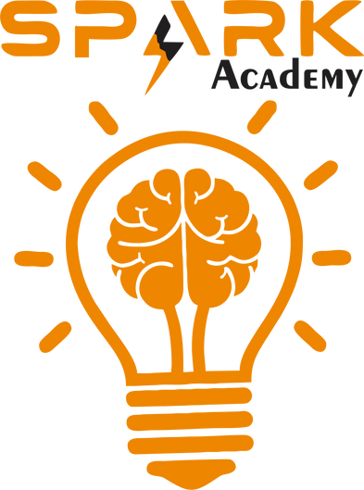
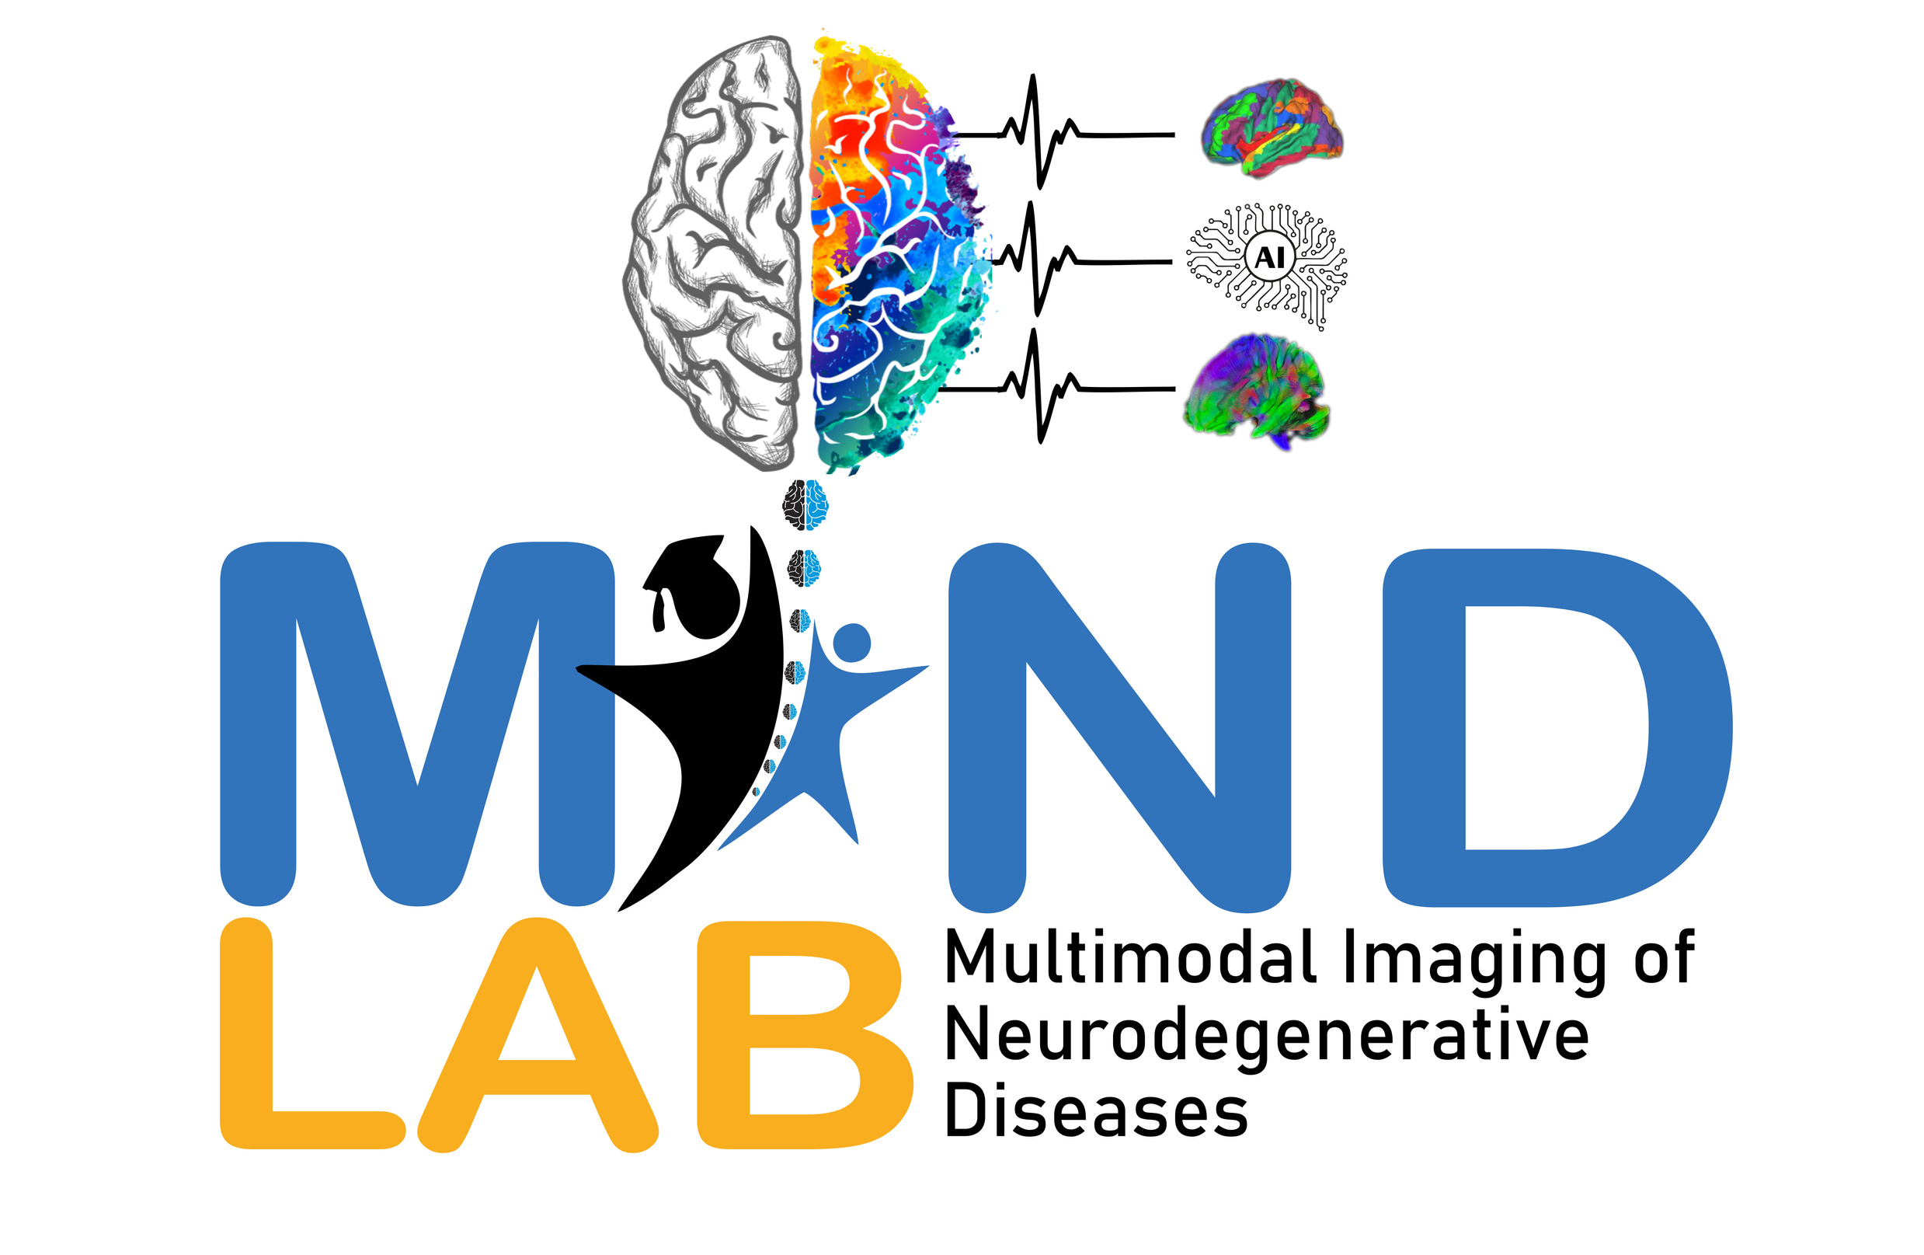



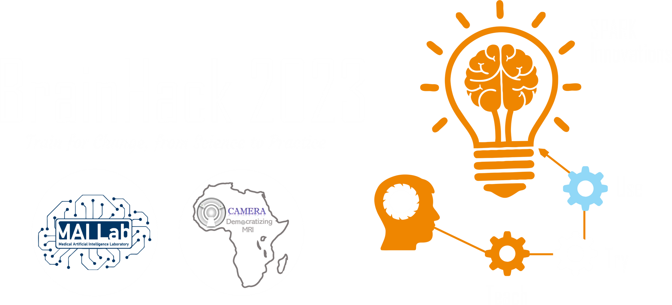


2025 SPARK ACADEMY
TRAIN FOR CHANGE, FROM SCIENCE TO PRACTICE
THE SPRINT AI TRAINING FOR AFRICAN MEDICAL
Imaging Knowledge Translation (SPARK)
Academy
IN DEEP LEARNING & MEDICAL IMAGING
Week 2: Introduction to Medical Imaging
DR UGUMBA KWIKIMA (MD, MMED, MSC-NEURORADIOLOGY)
SPECIALIST NEURORADIOLOGIST & LECTURER
MOI & MUHAS
DAR ES SALAAM, TANZANIA
1st March, 2025

Slide 2
Outline
Introduction
Basics of MRI signal generation
MRI Relaxation times
MRI pulse sequences
Spin Echo Techniques
Special MRI techniques
MR Artifacts
https://event.fourwaves.com/spark

Slide 3
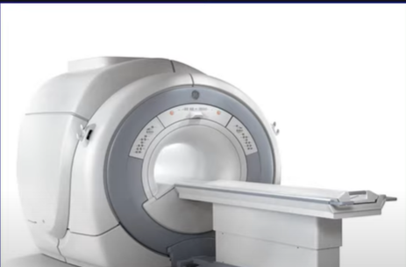
Magnetic Resonance Imaging
Imaging formation (e.g for lesion detection)
1.Signal
2. Localization
3. Resolution
-Contrast
-Spatial
-Temporal
Magnet
Large
Tiny
https://event.fourwaves.com/spark

Slide 4
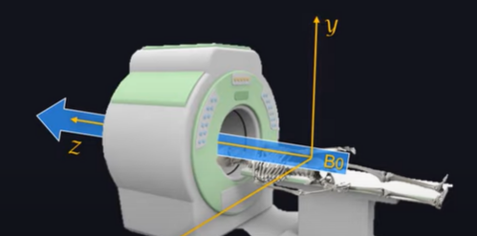
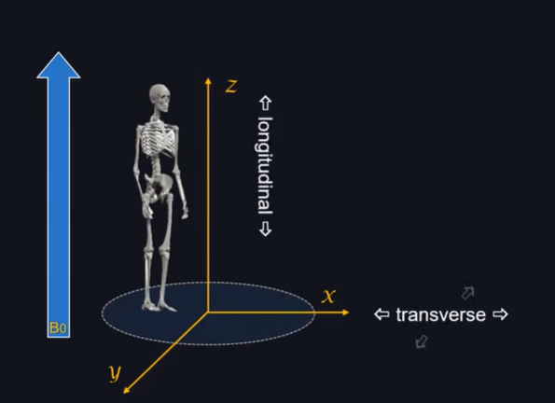
Large Magnet
B0 longitudinal magnetization
https://event.fourwaves.com/spark

Slide 5
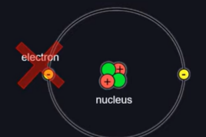
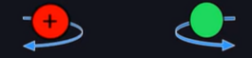
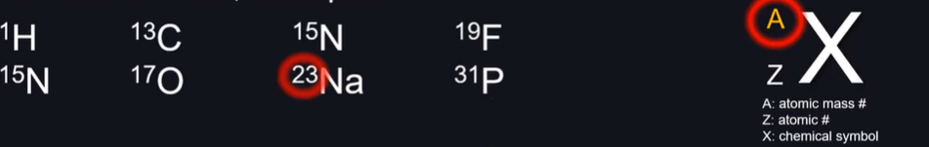
Tiny Magnets
MR active atoms
Atoms=Nucleus + Electrons
Nucleus= Protons + Neutrons
Mass number
Protons=Neutrons no net spin
Protons not= Neutrons Net spin
Spin Angular momentum
Spin Angular Momentum magnetic moment
MR Active Atoms
https://event.fourwaves.com/spark

Slide 6
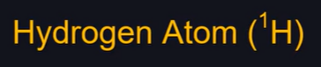
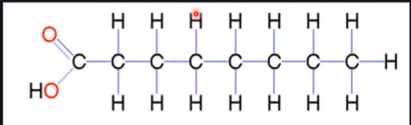
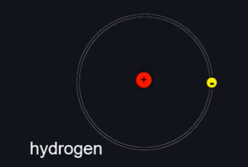
MRI uses strong magnetic fields and radio waves
Hydrogen nuclei (protons) are key to signal generation
Protons align with the magnetic field (B0)
Radiofrequency (RF) pulses excite protons
Signal is detected as protons return to equilibrium
Single proton + No neutron=Strong NMR effect
Most abundant atom in human body
H20
Fat
https://event.fourwaves.com/spark
Notes:
Hydrogen is abundant in the human body (mainly in water).Protons have a magnetic moment (spin).In a magnetic field, they align parallel or anti-parallel
Net magnetization vector (NMV) forms along B0. The basis of MRI signal depends on these properties

Slide 7
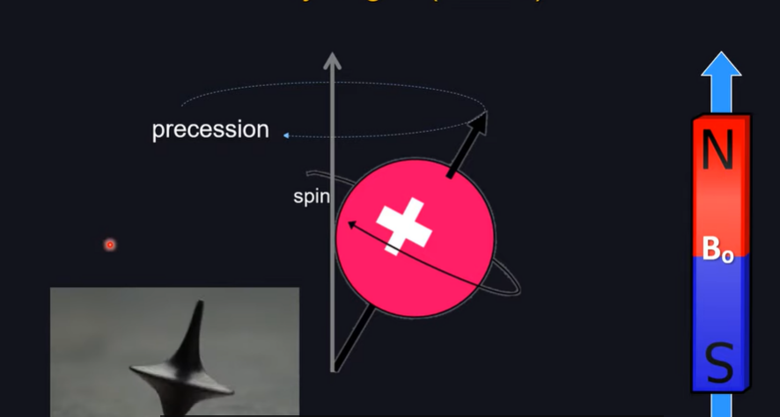
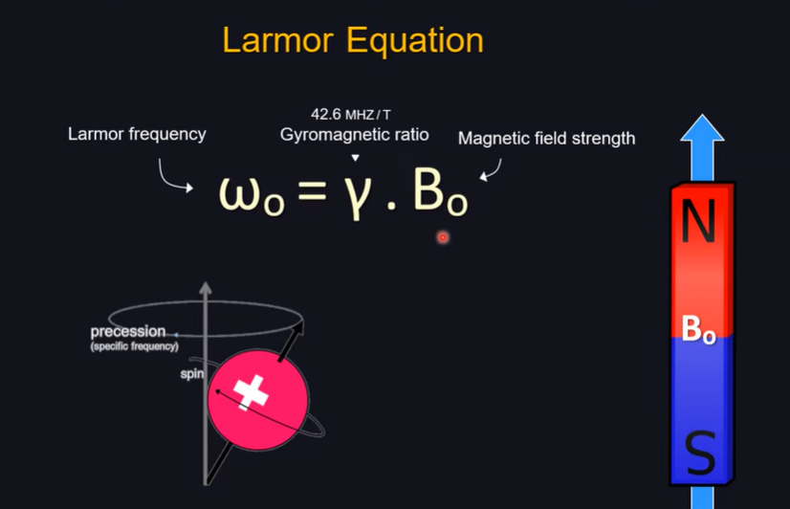
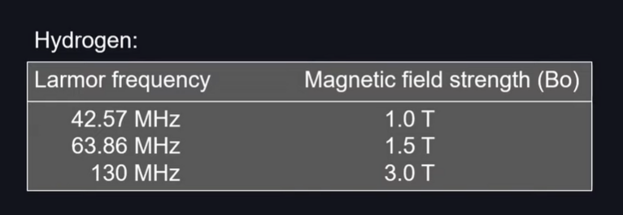
https://event.fourwaves.com/spark
Notes:
Protons precess around B0 at the Larmor frequency. Frequency depends on field strength and gyromagnetic ratio. Formula: f = γB0 (where γ is gyromagnetic ratio). Higher field strength = higher Larmor frequency. Precession allows controlled RF pulse interaction. Protons precess around B0 at the Larmor frequency
Frequency depends on field strength and gyromagnetic ratio. Formula: f = γB0 (where γ is gyromagnetic ratio). Higher field strength = higher Larmor frequency
Precession allows controlled RF pulse interaction

Slide 8
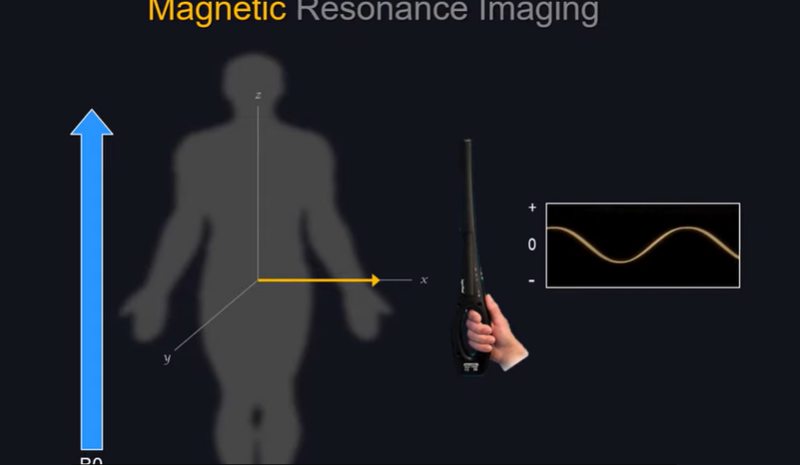
RF pulse at Larmor frequency excites protons
Energy absorption moves NMV away from B0
Flip angle depends on pulse strength & duration
Protons move into transverse plane
Once RF pulse stops, relaxation begins
https://event.fourwaves.com/spark
Notes:
Transverse Magnetization is required to generate signal

Slide 9
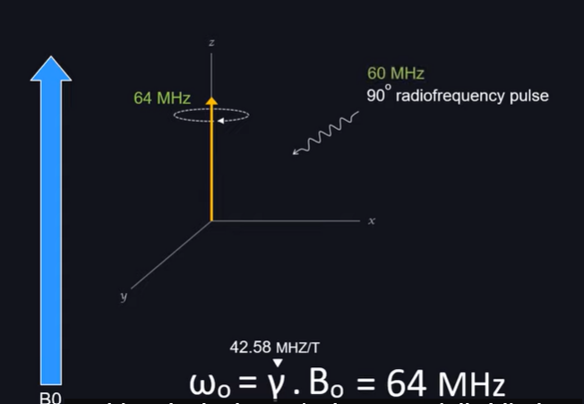
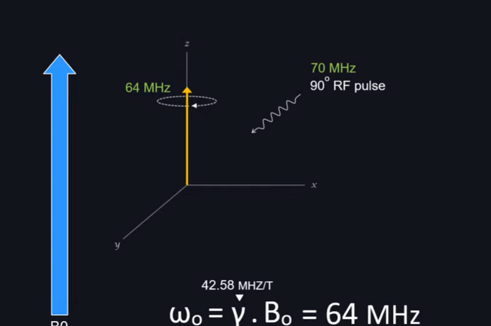
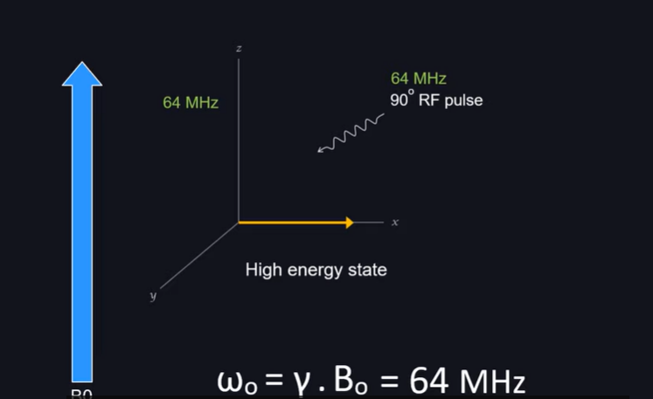
Resonance
https://event.fourwaves.com/spark
Notes:
A very effective way to transfer energy

Slide 10
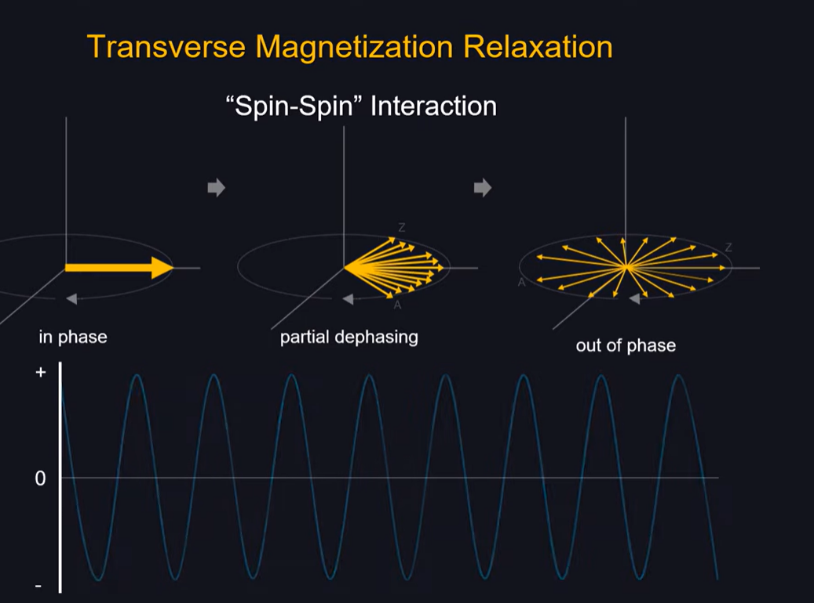
Protons lose phase coherence in transverse plane
Caused by spin-spin interactions
Longer T2 = brighter signal on T2-weighted MRI
Water has a long T2, appearing bright
Useful for detecting pathology (e.g., edema, tumors)
https://event.fourwaves.com/spark

Slide 11
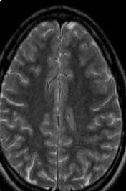
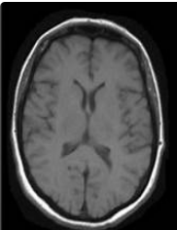
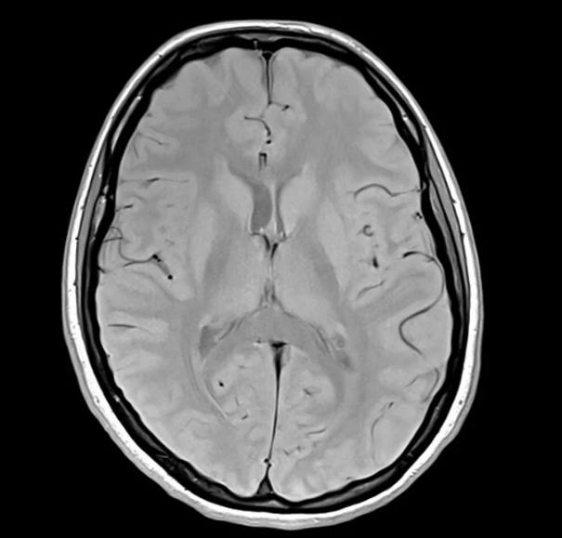
Signal detection and image formation
RF coil detects signal from precessing protons
Signal undergoes Fourier Transform to create images
Pulse sequences control contrast (T1, T2, PD, etc.)
Gradient fields encode spatial information
Image resolution depends on field strength & sequence
https://event.fourwaves.com/spark

Slide 12
Introduction to MRI relaxation
MRI contrast depends on tissue relaxation properties
Two key relaxation times: T1 (longitudinal) & T2 (transverse)
Relaxation describes how protons return to equilibrium after excitation
Different tissues have different T1 & T2 times
These properties influence image contrast in MRI
https://event.fourwaves.com/spark

Slide 13
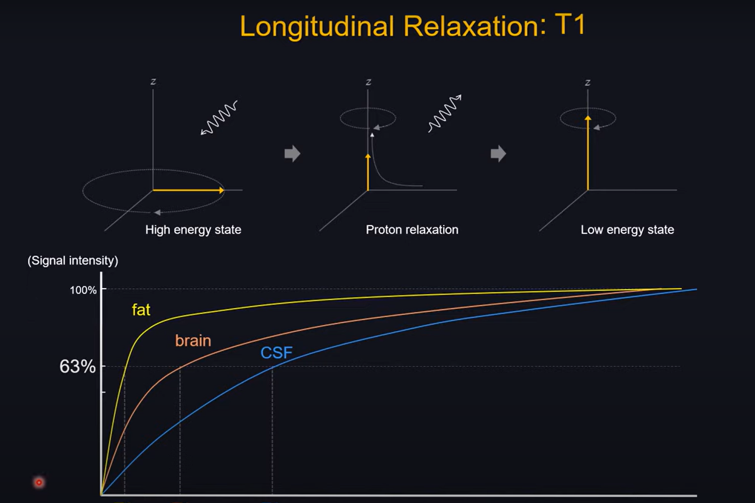
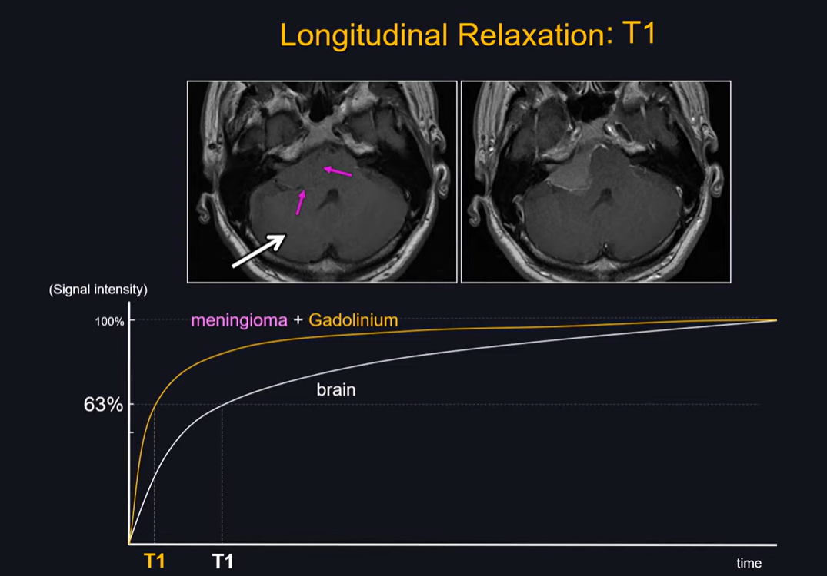
Protons realign with B0, releasing energy
T1 time varies by tissue (fat short, water long)
Shorter T1 = brighter signal on T1-weighted MRI
Used for anatomical detail & contrast enhancement
Faster field recovery means better signal detection
https://event.fourwaves.com/spark
Notes:
T1 is longer than T2 in most tissues. T1-weighted images: fat appears bright, water dark. T2-weighted images: water appears bright, fat darker. Pathology (e.g., edema, tumors) often appears bright on T2. Image contrast depends on TR (repetition time) and TE (echo time)

Slide 14
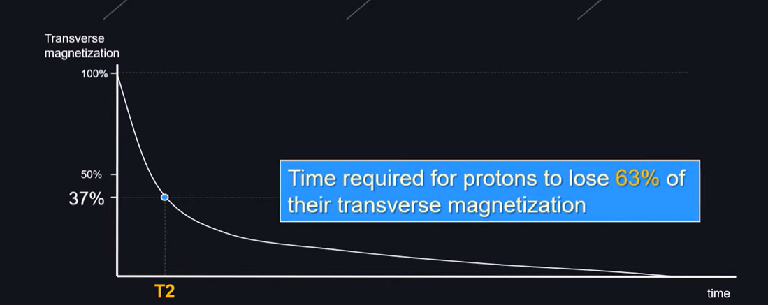
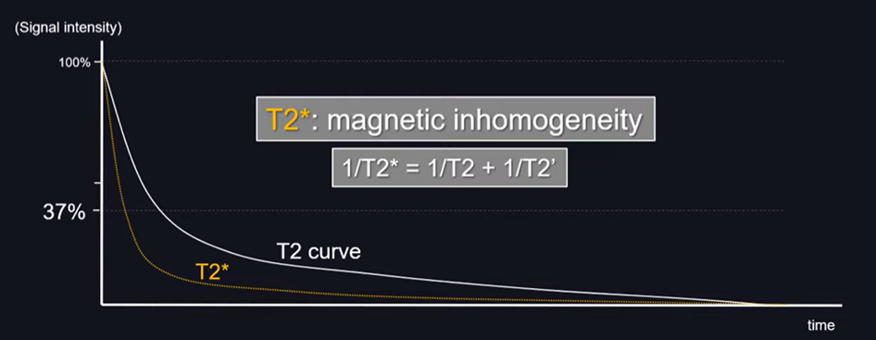
Also called spin-spin relaxation
Measures how fast protons lose phase coherence after excitation
Caused by interactions between nearby spinning protons
T2 decay is exponential and faster than T1 recovery
Shorter T2 = rapid signal loss = darker on T2-weighted images
https://event.fourwaves.com/spark

Slide 15
Factors Affecting Relaxation Times T1
Uses short TR (300–800 ms) and short TE (10–30 ms)
Fat appears bright, water appears dark
Best for anatomical detail, post-contrast imaging
Used in tumors, blood-brain barrier assessment
Gadolinium contrast enhances lesions with increased permeability
Magnetic field strength (B0): Higher B0 → longer T1, shorter T2
Tissue type: Fat has short T1/T2, water has long T1/T2
Temperature: Higher temp → faster T1 relaxation
Molecular interactions: More interactions → shorter T1/T2
Paramagnetic agents (e.g., gadolinium): Reduce T1 relaxation time
https://event.fourwaves.com/spark

Slide 16
Demo
Uses long TR (>2000 ms) and long TE (>80 ms)
Water appears bright, fat appears darker
Best for detecting edema, inflammation, and CSF
Useful in stroke, multiple sclerosis, infections
Pathological tissues with high water content appear hyperintense
https://event.fourwaves.com/spark

Slide 17
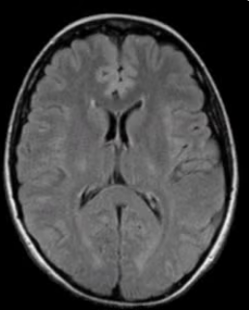
Inversion Recovery
FLAIR (Fluid-Attenuated Inversion Recovery): Suppresses CSF to highlight lesions
STIR (Short Tau Inversion Recovery): Suppresses fat for better soft tissue contrast
https://event.fourwaves.com/spark

Slide 18
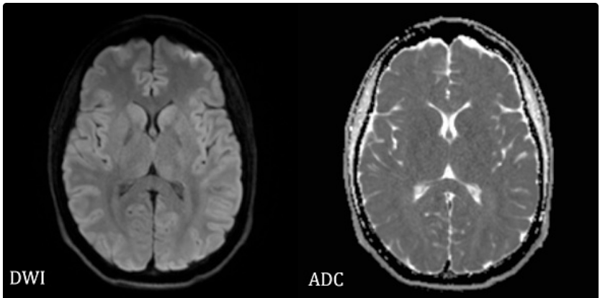
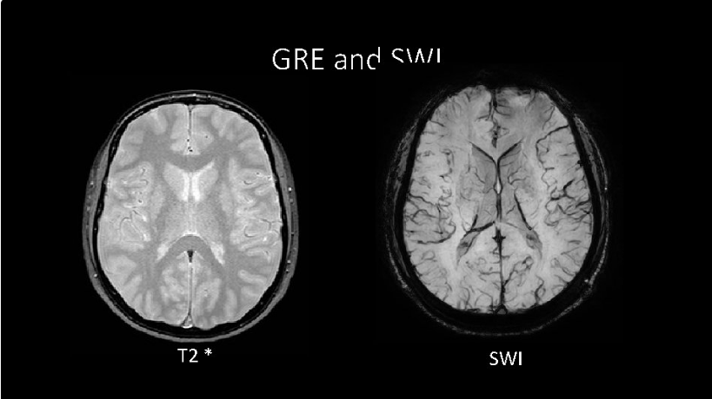
Special MRI Techniques For Relaxation
Diffusion-weighted imaging (DWI): Uses T2 effects to detect acute stroke
*T2 (Gradient Echo)**: Sensitive to blood products, useful for hemorrhage detection
Relaxometry techniques: Quantitative measurement of T1 & T2 times
https://event.fourwaves.com/spark

Slide 19
Introduction to MRI Pulse Sequences
MRI pulse sequences control how images are acquired.
They determine image contrast and tissue differentiation.
A sequence consists of RF pulses, gradients, and signal detection.
Pulse sequences can be spin-echo, gradient-echo, or specialized types.
Choosing the right sequence is critical for diagnostic accuracy.
https://event.fourwaves.com/spark
Notes:
Introduction to MRI Pulse Sequences

Slide 20
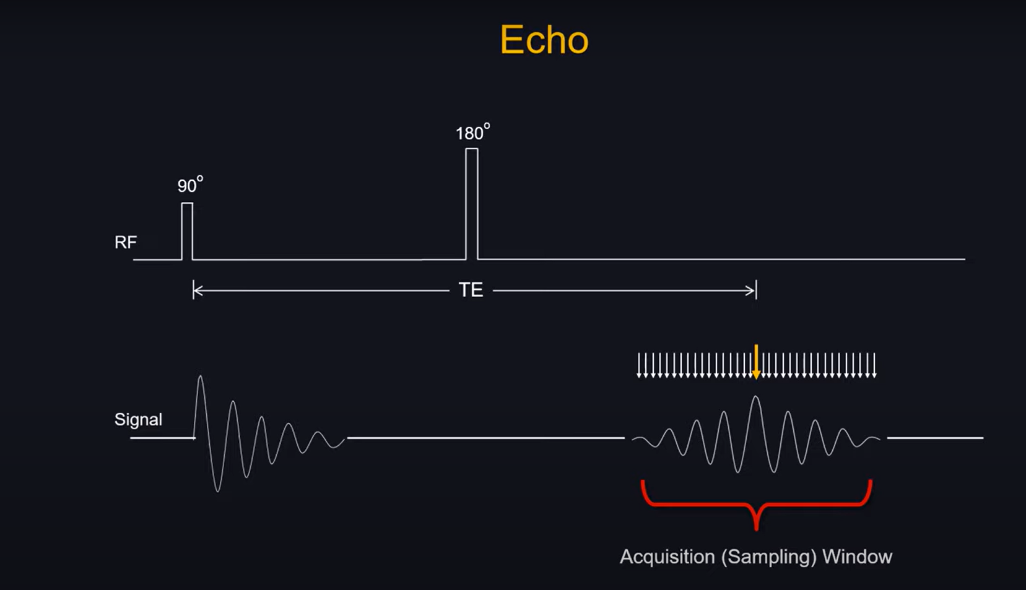
Spin-Echo (SE) Sequence
Gold standard for T1 and T2-weighted imaging.
Uses a 90° RF pulse followed by a 180° refocusing pulse.
Minimizes artifacts and provides high tissue contrast.
Commonly used in brain, spine, and musculoskeletal imaging.
Variants include turbo spin-echo (TSE) and fast spin-echo (FSE).
https://event.fourwaves.com/spark
Notes:
Mechanism of delaying signal formation
Hence allows manipulation of contrast using TE and TR

Slide 21
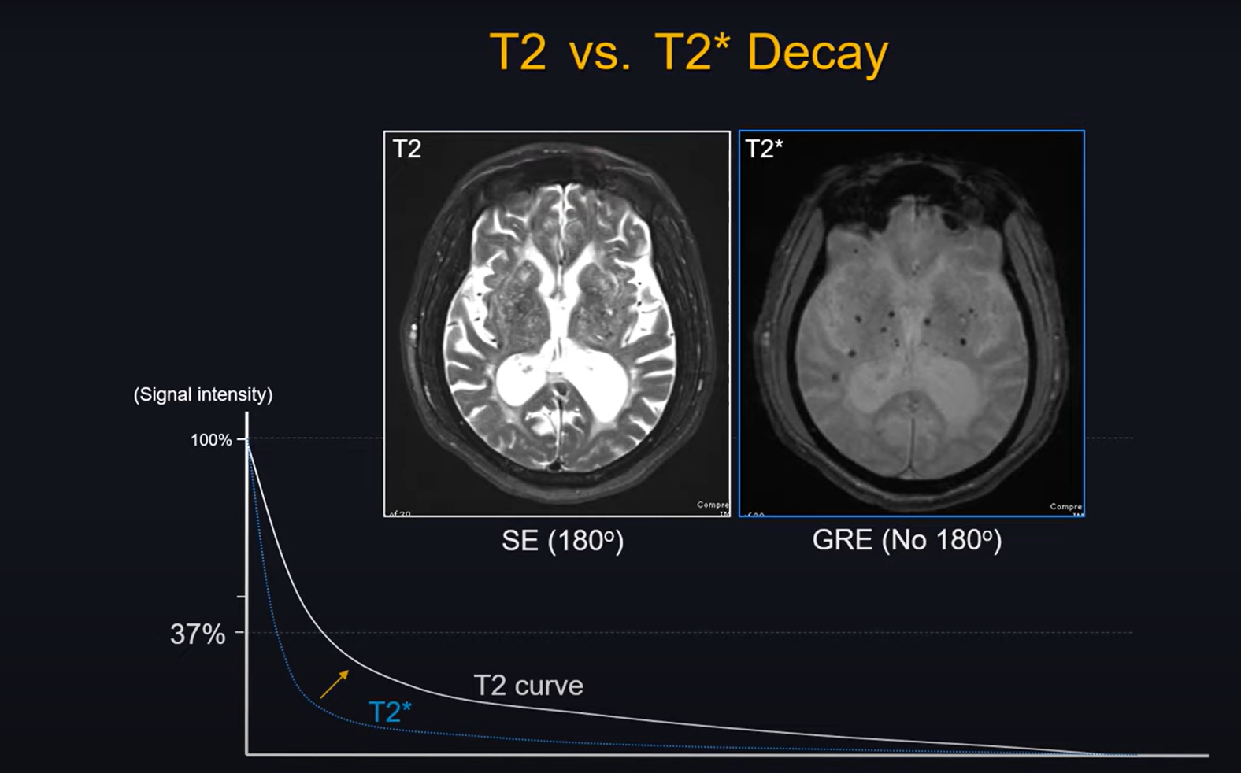
Github Classroom
https://event.fourwaves.com/spark

Slide 22
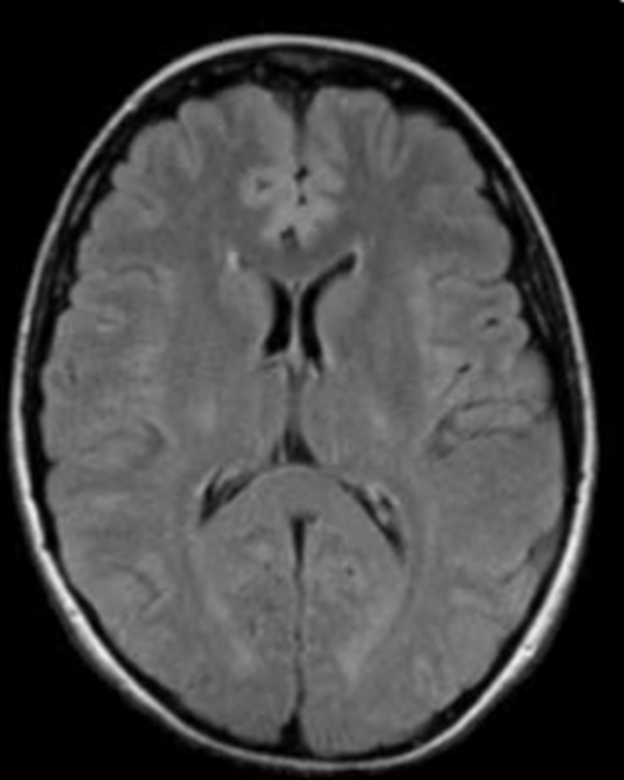
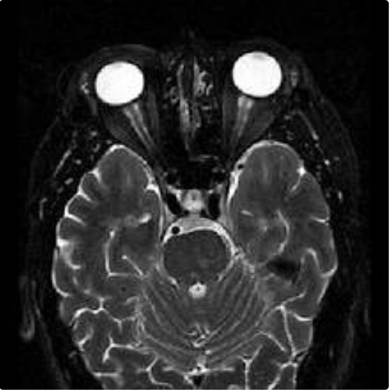
Inversion Recovery Sequence
Uses a 180° inversion pulse before standard SE sequence.
Suppresses specific tissue signals (e.g., fat in STIR, fluid in FLAIR).
Short-TI Inversion Recovery (STIR) enhances lesion detection.
Fluid-Attenuated Inversion Recovery (FLAIR) highlights pathology.
Useful in brain, spinal cord, and musculoskeletal imaging.
https://event.fourwaves.com/spark

Slide 23
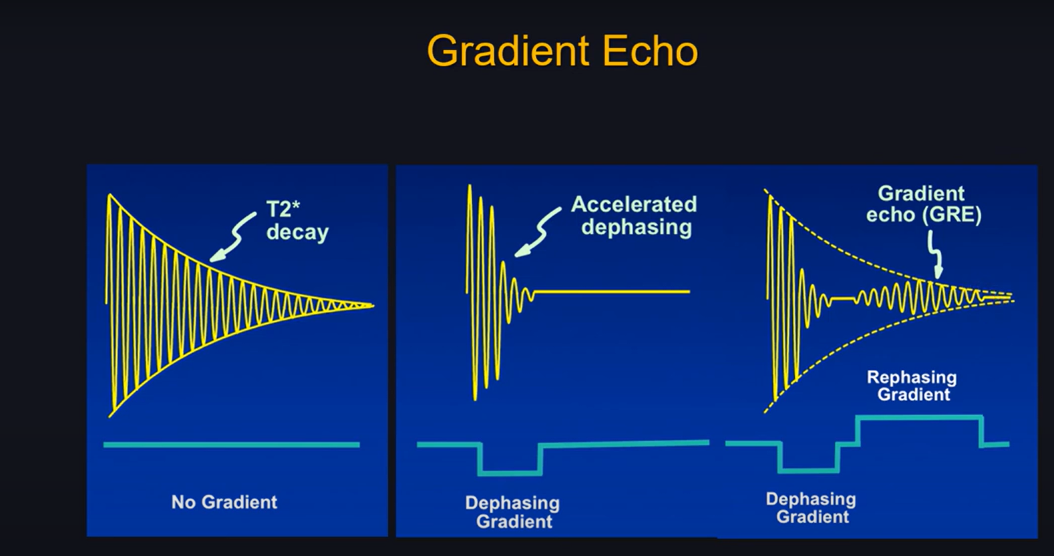
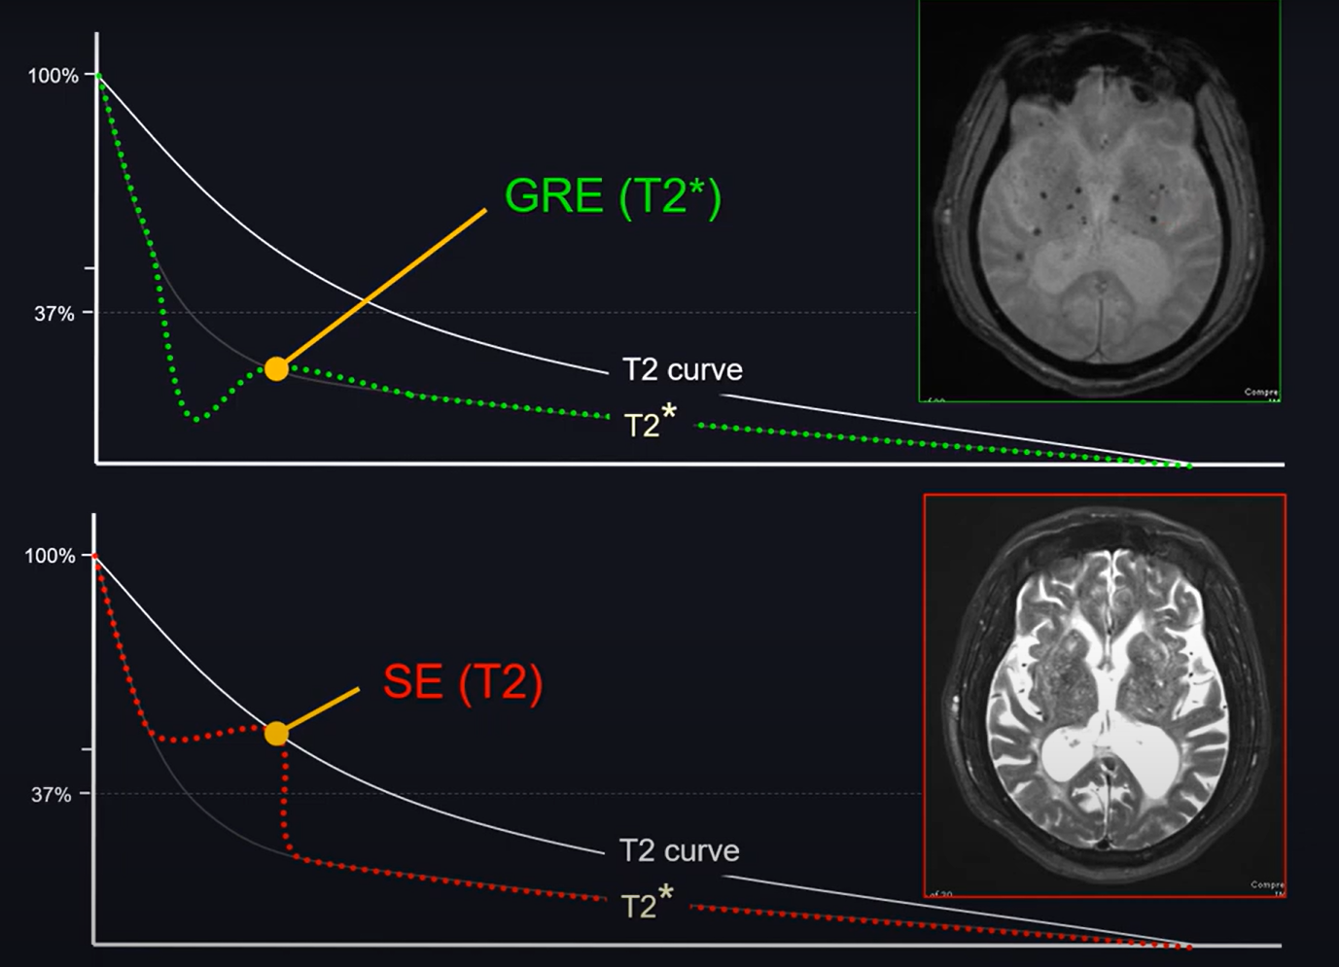
Gradient-Echo (GRE) Sequence
Uses variable flip angles and lacks a 180° refocusing pulse.
Produces T2* contrast, which is sensitive to hemorrhage and metal.
Faster than SE, allowing high-resolution 3D imaging.
Common in functional MRI (fMRI) and perfusion imaging.
Variants include T2*-weighted GRE and Steady-State Free Precession (SSFP).
https://event.fourwaves.com/spark

Slide 24
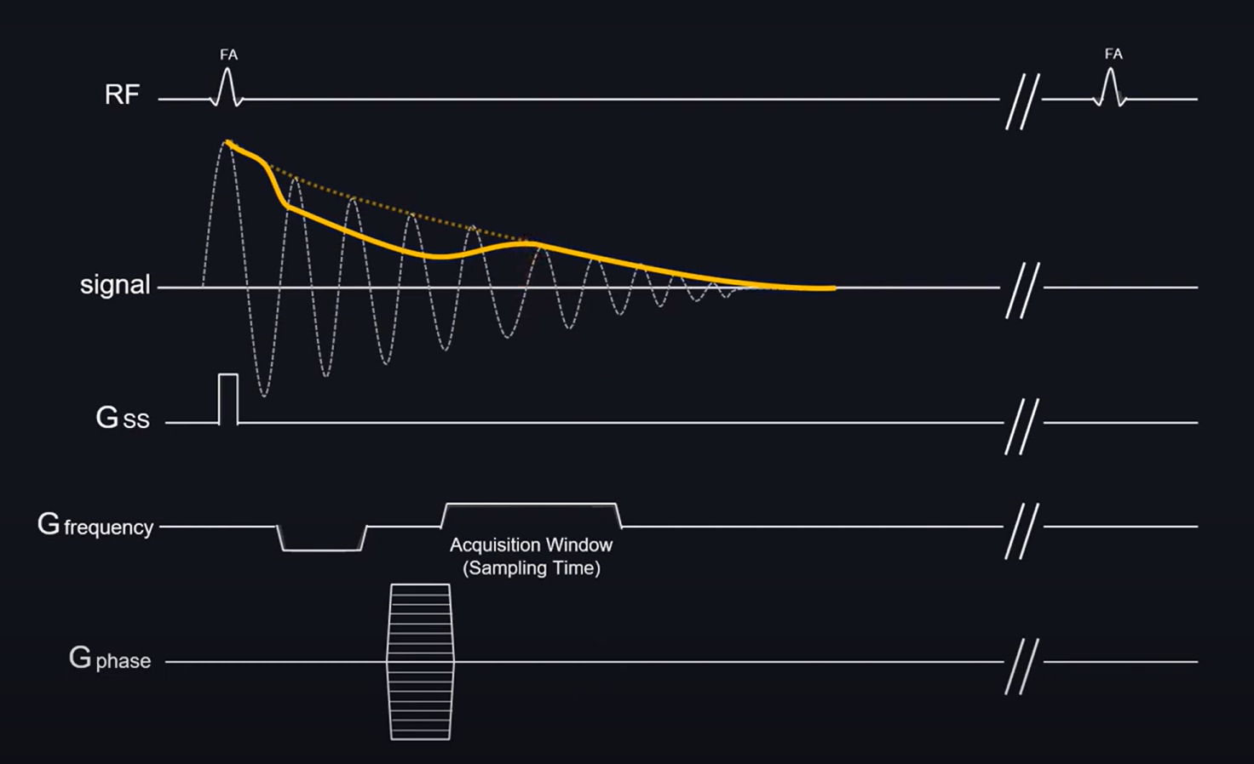
Susceptibility artifact
Not relying on 180 for dephasing and rephasing
Using rapid gradients instead
Partial flip angle (<90 degrees)
https://event.fourwaves.com/spark

Slide 25
Extremely fast imaging technique using multiple gradient echoes.
Used in fMRI, diffusion-weighted imaging (DWI), and perfusion MRI.
Sensitive to motion artifacts but allows real-time imaging.
Can be single-shot or multi-shot for improved resolution.
Essential for stroke assessment and brain function studies
DWI measures water molecule motion, crucial for stroke detection.
High sensitivity to early ischemic changes.
DTI maps white matter tracts using anisotropic diffusion.
Used in neuroimaging to assess brain connectivity.
Key parameters: Apparent Diffusion Coefficient (ADC) and Fractional Anisotropy (FA).
https://event.fourwaves.com/spark

Slide 26
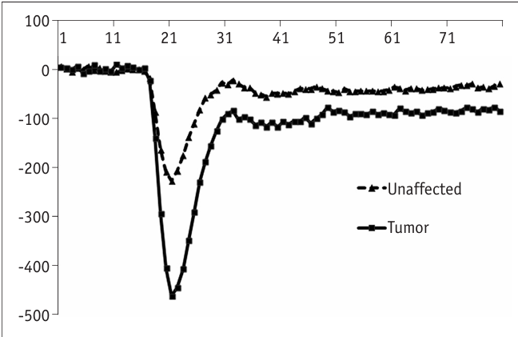
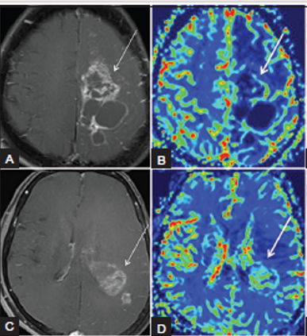
Perfusion-Weighted Imaging (PWI) Sequences
Measures blood flow dynamics in tissues.
Used in stroke, tumor, and dementia imaging.
Techniques include Dynamic Susceptibility Contrast (DSC) and Arterial Spin Labeling (ASL).
DSC uses contrast agents; ASL is non-invasive.
Provides maps of cerebral blood volume (CBV) and flow (CBF).
https://event.fourwaves.com/spark

Slide 27
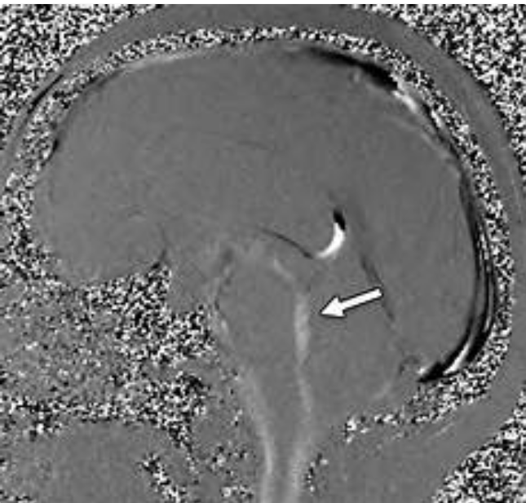
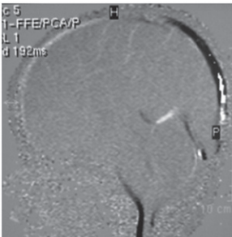
Cine Phase-Contrast MRI
Captures dynamic blood flow and cerebrospinal fluid (CSF) motion.
Uses velocity-encoded gradients for quantitative flow measurements.
Commonly used in cardiac and CSF flow studies.
Helps evaluate hydrocephalus and congenital heart disease.
Non-invasive alternative to catheter-based techniques
https://event.fourwaves.com/spark

Slide 28
Introduction to Spin Echo (SE)
Developed to correct inhomogeneities and field variations
Based on 90° excitation and 180° refocusing pulses
Used to generate T1-weighted, T2-weighted, and PD images
Provides high signal-to-noise ratio (SNR) and good tissue contrast
Fundamental to many advanced MRI techniques
https://event.fourwaves.com/spark

Slide 29

Initial 90° RF pulse flips spins into the transverse plane
A 180° RF refocusing pulse reverses dephasing
Echo signal forms at echo time (TE)
Repetition time (TR) determines contrast weighting
Image contrast depends on T1, T2, and proton density
https://event.fourwaves.com/spark

Slide 30
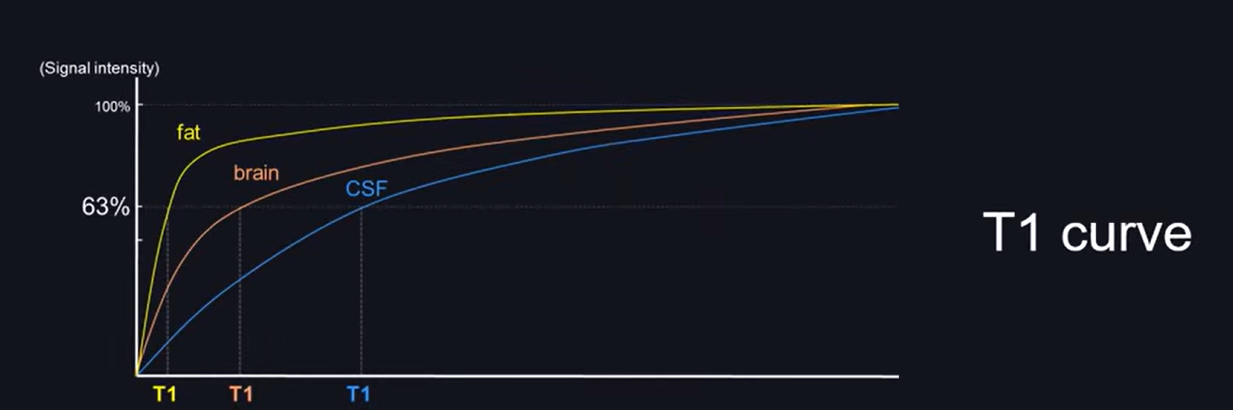
T1-Weighted Imaging with SE
Short TR (300–700 ms) and short TE (10–30 ms)
Highlights fat, while fluid appears dark
Good for anatomical details and post-contrast imaging
Used in brain, spine, and musculoskeletal imaging
Helps in detecting tumors, inflammation, and enhancement patterns
https://event.fourwaves.com/spark

Slide 31
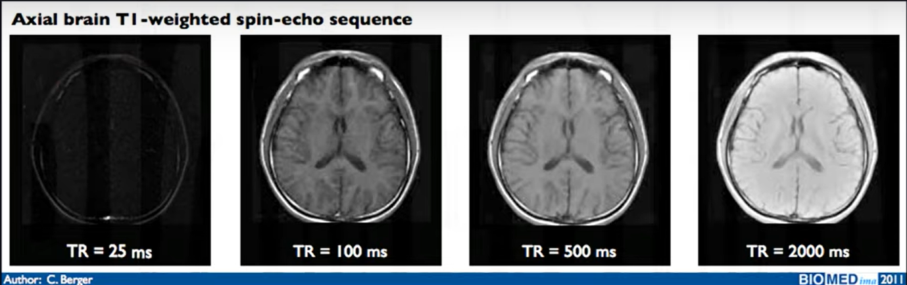
Parameter that is important for T1WI is TR
Maximize T1 contrast-short TR
Minimizing T1 contrast-long TR
https://event.fourwaves.com/spark

Slide 32
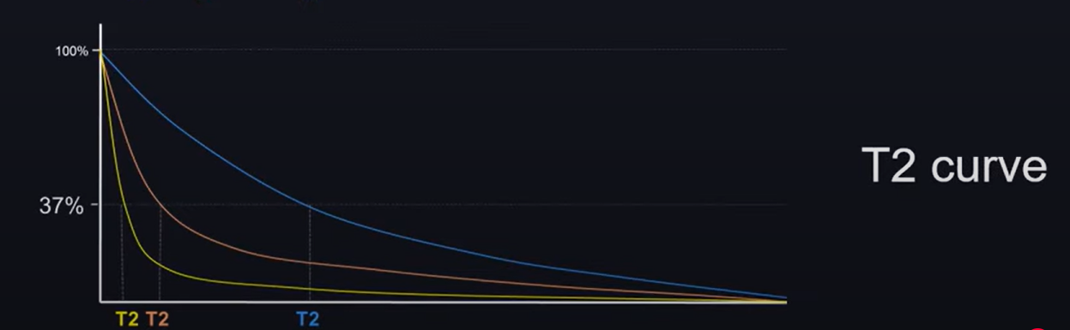
T2-Weighted Imaging with SE
Long TR (2000+ ms) and long TE (70+ ms)
Fluid (CSF, edema) appears bright, fat is dark
Excellent for pathology detection (e.g., tumors, strokes, infections)
Used in brain, spine, and musculoskeletal imaging
Can differentiate between acute and chronic conditions
https://event.fourwaves.com/spark

Slide 33
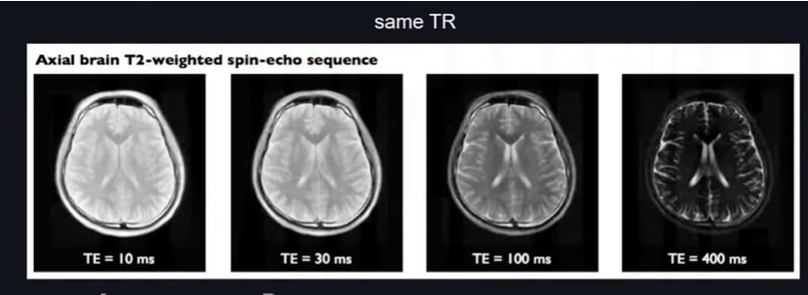
Parameter that is important for T2WI is TE
Maximize T2 contrast-long TE
Minimizing T2 contrast-short TE
https://event.fourwaves.com/spark

Slide 34

Proton Density (PD)-Weighted SE
Intermediate TR and TE settings
Balances T1 and T2 effects for high tissue contrast
Good for joint cartilage and brain imaging
Helps in assessing subtle pathology
Reduces fluid suppression compared to T2
https://event.fourwaves.com/spark

Slide 35
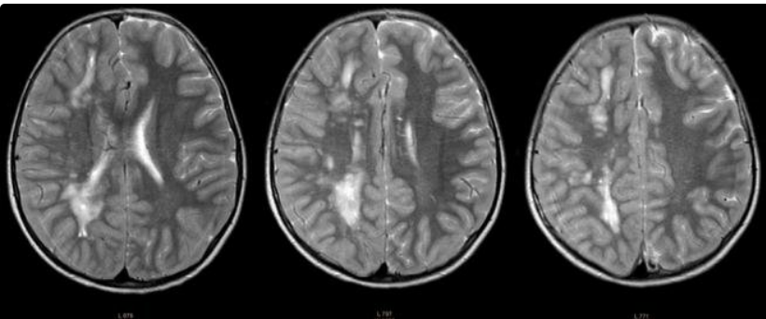
Fast Spin Echo (FSE)/Turbo Spin Echo (TSE)
Uses multiple 180° refocusing pulses per TR cycle
Reduces scan time significantly compared to conventional SE
Produces higher SNR with better spatial resolution
Reduces motion artifacts in clinical applications
Commonly used in brain, spine, and musculoskeletal imaging
https://event.fourwaves.com/spark

Slide 36
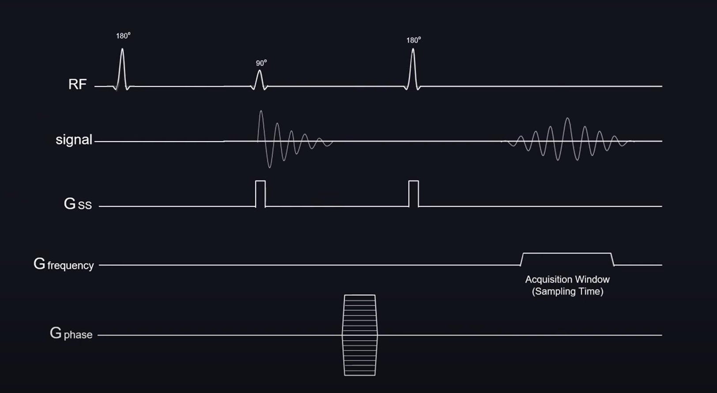
Inversion Recovery (IR) SE Techniques
Uses an initial 180° inversion pulse before SE sequence
STIR (Short-TI IR): Suppresses fat signal
FLAIR (Fluid-Attenuated IR): Suppresses CSF signal
Enhances contrast for lesion detection
Applied in neuro, musculoskeletal, and cardiac imaging
https://event.fourwaves.com/spark

Slide 37
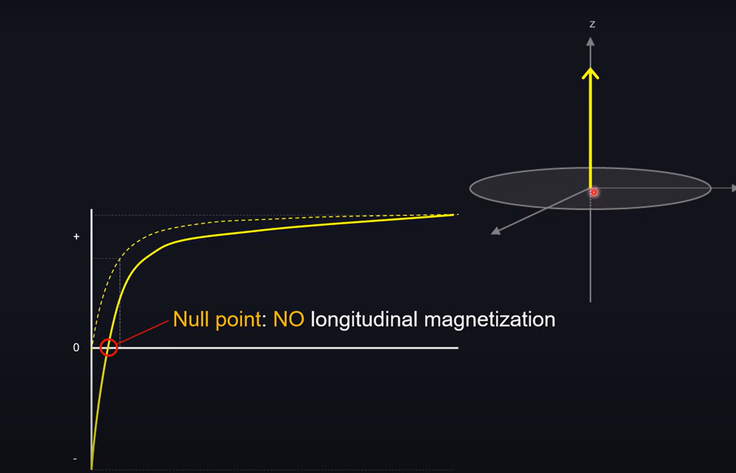
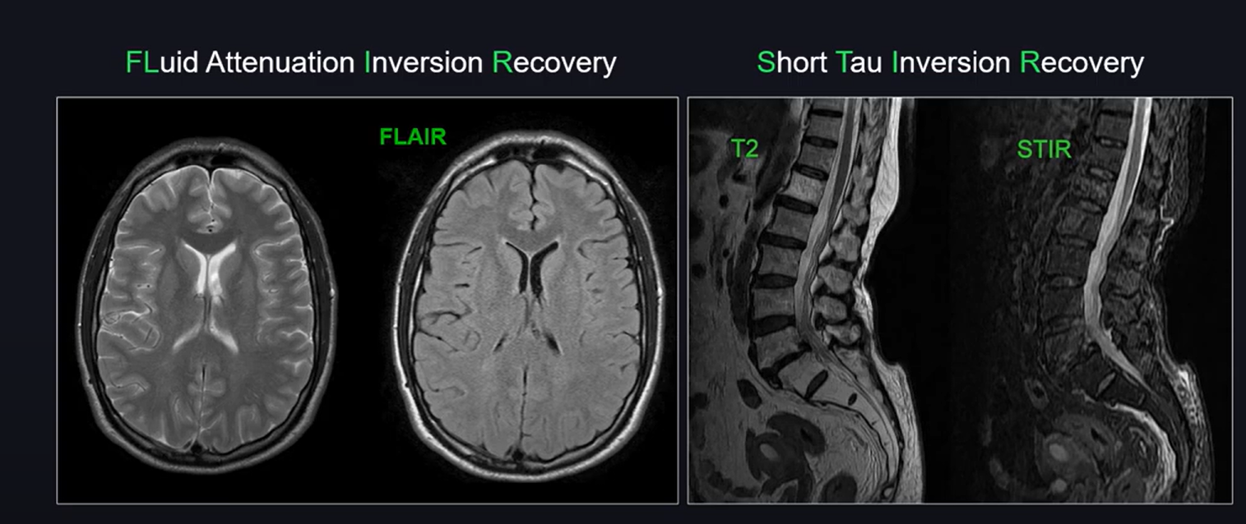
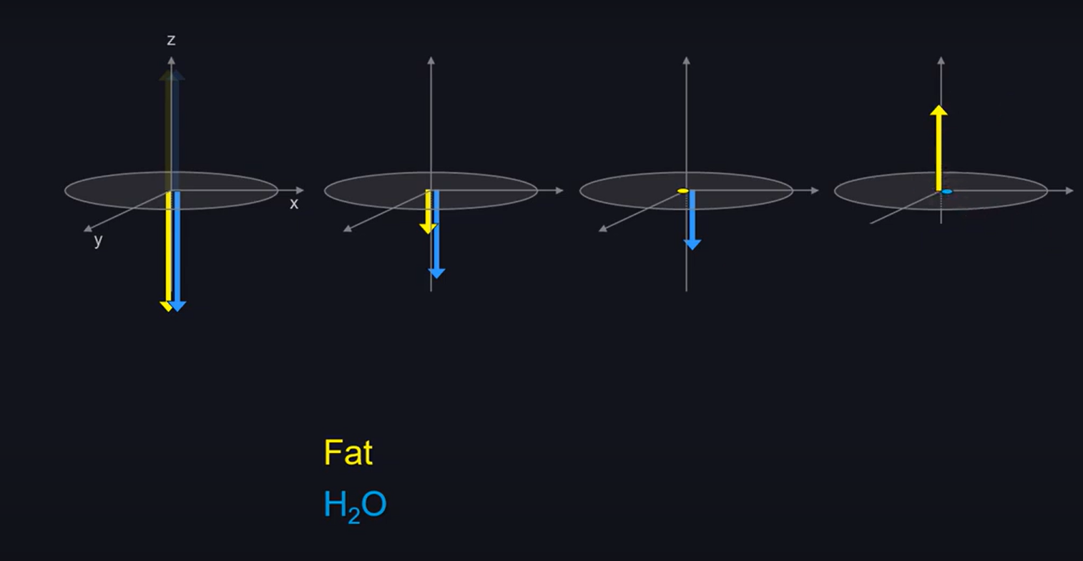
https://event.fourwaves.com/spark

Slide 38


https://event.fourwaves.com/spark

Slide 39


Applications of Spin Echo Techniques
Brain imaging: Tumors, strokes, demyelination (MS)
Spine imaging: Disc herniation, cord pathology
Musculoskeletal: Ligaments, cartilage, and joint pathology
Abdominal imaging: Liver, kidneys, and pancreas assessment
Cardiac MRI: Evaluating myocardial tissue characteristics
https://event.fourwaves.com/spark

Slide 40
Introduction to Special MR Techniques
Magnetic Resonance Imaging (MRI) has evolved beyond conventional T1- and T2-weighted imaging
Advanced MR techniques provide enhanced tissue characterization
These techniques improve diagnostic accuracy and treatment planning
Specialized MR sequences help in neurological, oncological, and musculoskeletal imaging
This presentation explores key MR techniques and their clinical applications
https://event.fourwaves.com/spark

Slide 41

Diffusion-Weighted Imaging (DWI)
Measures molecular water diffusion within tissues
Useful in detecting acute ischemic stroke within minutes
Helps differentiate abscesses from tumors in neuroimaging
Plays a role in oncologic imaging (e.g., tumor grading, treatment response)
Commonly used in stroke, infections, and oncology
https://event.fourwaves.com/spark

Slide 42


Diffusion Tensor Imaging (DTI)
Extends DWI to analyze white matter integrity
Uses fractional anisotropy (FA) to assess fiber tract directionality
Crucial for pre-surgical mapping of brain pathways
Helps in diagnosing multiple sclerosis and traumatic brain injury
Key technique for connectomics and brain network studies
https://event.fourwaves.com/spark

Slide 43

Perfusion-Weighted Imaging (PWI)
Evaluates tissue vascularity and blood flow dynamics
Differentiates high-grade from low-grade tumors
Useful in stroke imaging for penumbra assessment
Common techniques: Dynamic Susceptibility Contrast (DSC), Dynamic Contrast-Enhanced (DCE), Arterial Spin Labeling (ASL)
Plays a role in neuro-oncology and dementia imaging
https://event.fourwaves.com/spark

Slide 44

Spectroscopy (MRS)
Provides metabolic profiling of tissues
Identifies biochemical markers like choline, creatine, NAA, and lactate
Helps differentiate tumor recurrence from radiation necrosis
Useful in neurodegenerative disorders, epilepsy, and metabolic diseases
Non-invasive alternative to biopsy in some cases
https://event.fourwaves.com/spark

Slide 45

Susceptibility-Weighted Imaging (SWI)
Detects magnetic susceptibility differences in tissues
Excellent for identifying microbleeds, calcifications, and venous structures
Useful in traumatic brain injury, stroke, and neurodegenerative diseases
Enhances detection of hemorrhagic transformation in stroke
Helps in characterizing vascular malformations
https://event.fourwaves.com/spark

Slide 46

Functional MRI (fMRI)
Measures brain activity via blood oxygen level-dependent (BOLD) signals
Maps functional regions of the brain pre-surgery
Used in cognitive and psychiatric research
Assists in stroke rehabilitation and neuroplasticity studies
Helps in understanding brain connectivity and disorders like epilepsy
https://event.fourwaves.com/spark

Slide 47


Cine Phase-Contrast MRI
Evaluates cerebrospinal fluid (CSF) flow dynamics
Essential in hydrocephalus and Chiari malformation assessments
Helps in predicting outcomes for Endoscopic Third Ventriculostomy (ETV)
Used in cardiovascular imaging for blood flow assessment
Non-invasive alternative for evaluating flow-related disorders
https://event.fourwaves.com/spark

Slide 48
Introduction to MRI Artifacts
MRI artifacts are distortions or errors in imaging.
They can arise from hardware, software, or patient-related factors.
Artifacts may mimic pathology or obscure real findings.
Understanding artifacts is crucial for accurate diagnosis.
They can be minimized with optimized imaging techniques.
https://event.fourwaves.com/spark

Slide 49
Types of MRI Artifacts
Hardware/Acquisition
Human body/Physiology/Implants
(RF)Zipper artifact
Truncation/Gibbs
Aliasing
Ghosting
Susceptibility
Motion
Flow
Chemical shift
https://event.fourwaves.com/spark

Slide 50

Zipper Artifacts
RF interference
Room not properly shielded
RF source may be in the room
e.g. Electronic devices
https://event.fourwaves.com/spark

Slide 51

Motion Artifacts
Caused by voluntary or involuntary patient movement.
Appears as ghosting or blurring in the image.
Common in restless patients or uncooperative children.
Can be reduced with faster sequences and motion correction techniques.
Breath-holding or sedation may be required in certain cases.
https://event.fourwaves.com/spark
Notes:
• Motion leads to phase errors in the data which leads to misregistrationin the phase encode (y) direction
• periodic motion leads to ghosting (shifted images that can
constructively or destructively interfere with the primary image)
• correct for motion induced phase errors
• fast imaging to freeze motion
• follow motion

Slide 52

Metal Artifacts
Occur due to metallic implants, surgical clips, or foreign bodies.
Appear as signal voids, distortions, or blooming effects.
More prominent in gradient-echo sequences.
Can be minimized using metal artifact reduction sequences (MARS).
Using STIR or fast spin-echo sequences helps reduce effects.
https://event.fourwaves.com/spark

Slide 53

Susceptibility Artifacts
Caused by magnetic field variations in different tissues.
Common in air-tissue interfaces (e.g., sinuses, lungs).
More pronounced in GRE sequences compared to spin-echo.
Can mimic microhemorrhages or calcifications.
Using higher bandwidth and reducing TE helps mitigate them.
https://event.fourwaves.com/spark

Slide 54

Gibbs Ringing Artifact
Occurs due to sharp transitions in image intensity.
Appears as parallel lines near high-contrast areas.
Related to insufficient spatial resolution.
More noticeable in brain imaging near CSF borders.
Mitigation: Increasing matrix size or applying filters.
https://event.fourwaves.com/spark

Slide 55

Aliasing (Wrap-Around) Artifact
Happens when the field of view (FOV) is too small.
Structures outside the FOV appear on the opposite side.
Common in head and spine imaging.
Can be reduced by increasing FOV or using saturation bands.
Phase oversampling helps prevent aliasing.
https://event.fourwaves.com/spark

Slide 56


Chemical Shirt Artifact
Occurs in frequency encoding direction
Spatial misregistration of fat and water molecules
Precession frequency is higher in hydrogen atoms of water compared to that of fat
Chemical shift increases with magnetic field strength
Increasing the bandwidth will decrease the artifact
https://event.fourwaves.com/spark
Notes:
Oxygen atoms in water molecules attract electron clouds and reduce electron clouds around hydrogen atoms while no significant such effect occurs in hydrogen atom of fat. The lesser the electron cloud, the higher the effect of static magnetic field, so higher the precession frequency

Slide 57


Pulsation/Flow Artifact
CSF flow results in TOF loss and FRE effects
TOF loss typically occurs in SE & FSE when protons do not experience RF pulses
FRE entry slice phenomenon
TOF loss-short TE, imaging parallel to the flow, and thick slice
FRE-Saturation bands
https://event.fourwaves.com/spark

Slide 58


Ghosting Artifact
Resulting from periodic motions such as CSF pulsation, cardiac motion, and respiratory motion
Occurs along the phase encoding direction
Ghosts can be bright or dark
Mitigations-Increase the number of excitations, and swap phase encoding direction
https://event.fourwaves.com/spark

Slide 59
2025 SPARK ACADEMY
TRAIN FOR CHANGE, FROM SCIENCE TO PRACTICE
Thank you

